Slide 1

Understanding and Modelling the epidemic – COVID – 19 for United.States
By:
Abhishek Dabas

Slide 2

Order of Jupyter Notebook
Library Import
Load dataset
Data Inspection & Cleaning
Plotting & Vizualization
Data Modelling
Conclusion

Slide 3
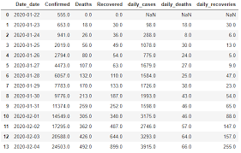

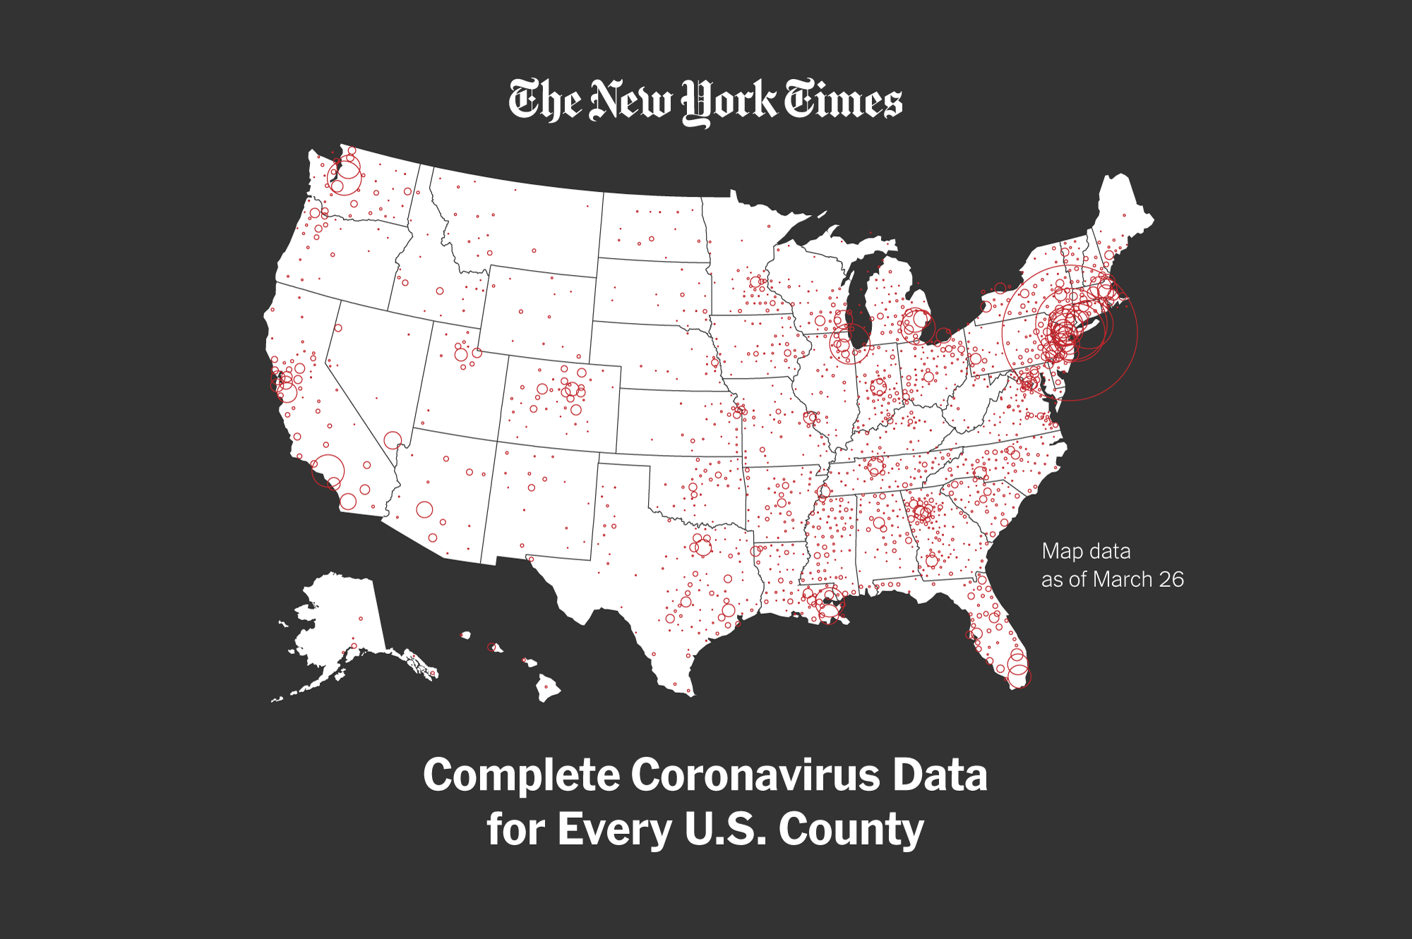
Data Sources(U.S covid-19):
NYTimes Covid Dataset – Date, State/County, Cases, Deaths
Link: https://github.com/nytimes/covid- 19-data
NovelCoronaVirus Dataset - https://data.humdata.org/dataset/novel-coronavirus-2019-ncov-cases
Population Dataset

Slide 4
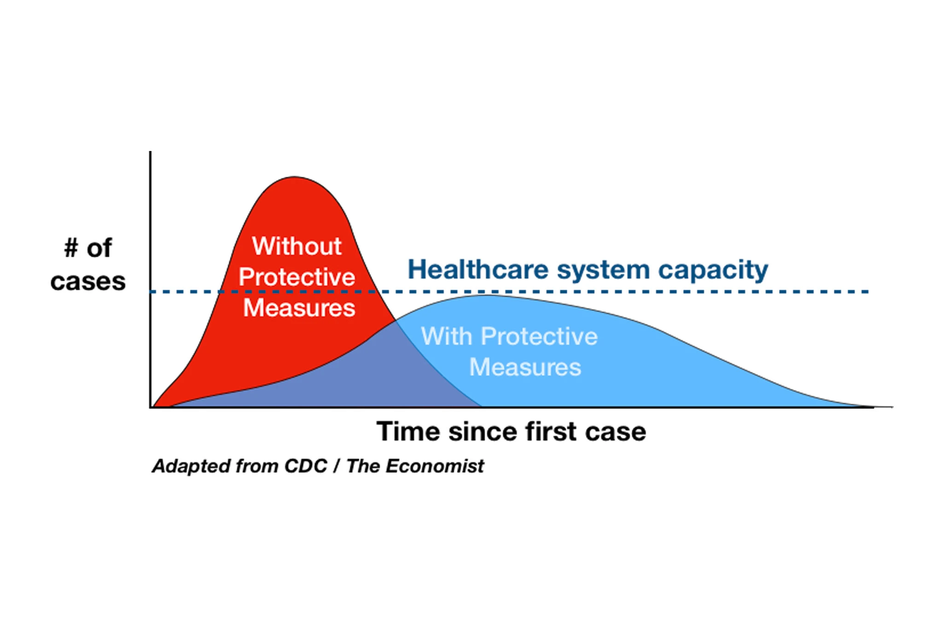
“Flatten the Curve”- The goal of this is to reduce the epidemic and halt the spread. Trying to reduce the number of cases that are going on actively at that point of time, which in turn gives the doctors and govt to be prepared and respond to the situation. The more people reporting with the virus on a given day, the higher the curve; a high curve means the virus is spreading fast. A low curve shows that the virus is spreading slower Basically when, R0 drops to zero, the United States is free of viruses.

Slide 5

Vizualizations :

Slide 6

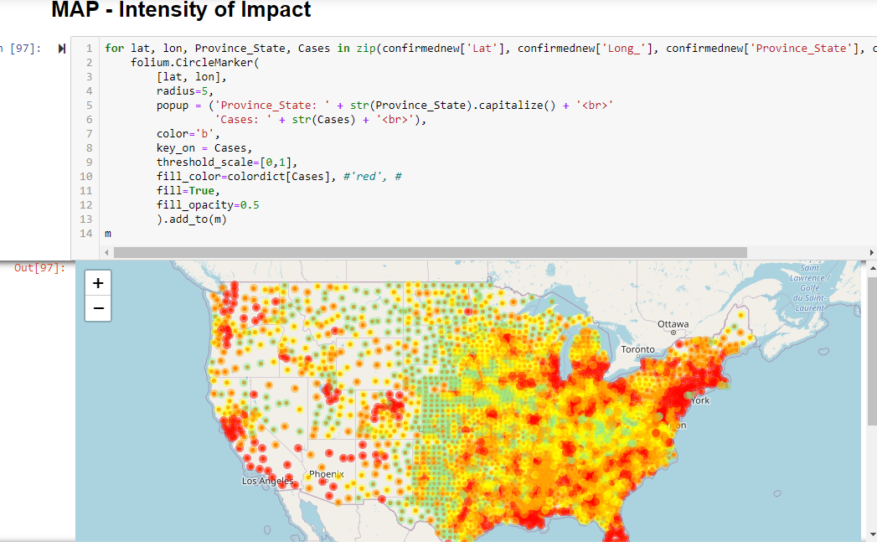
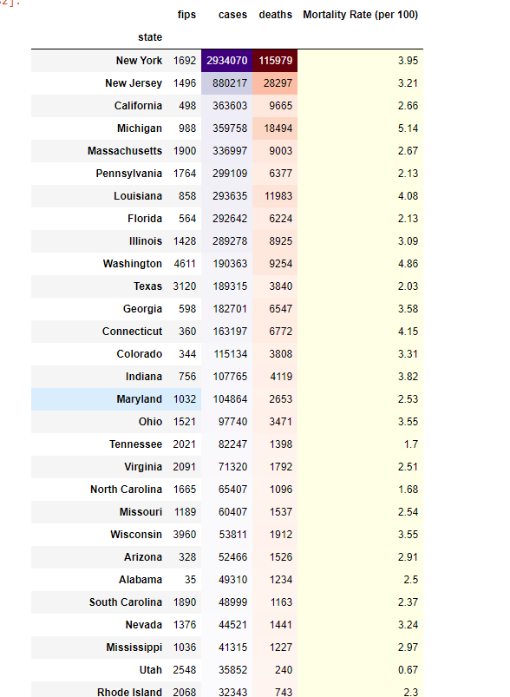
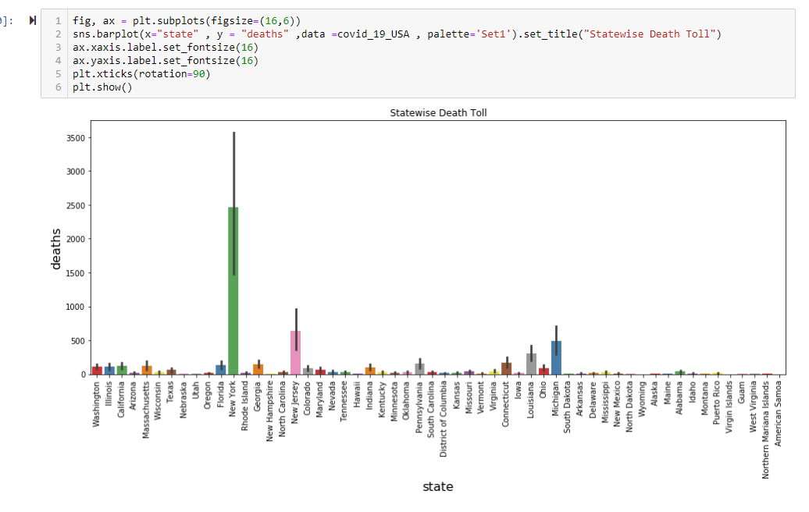
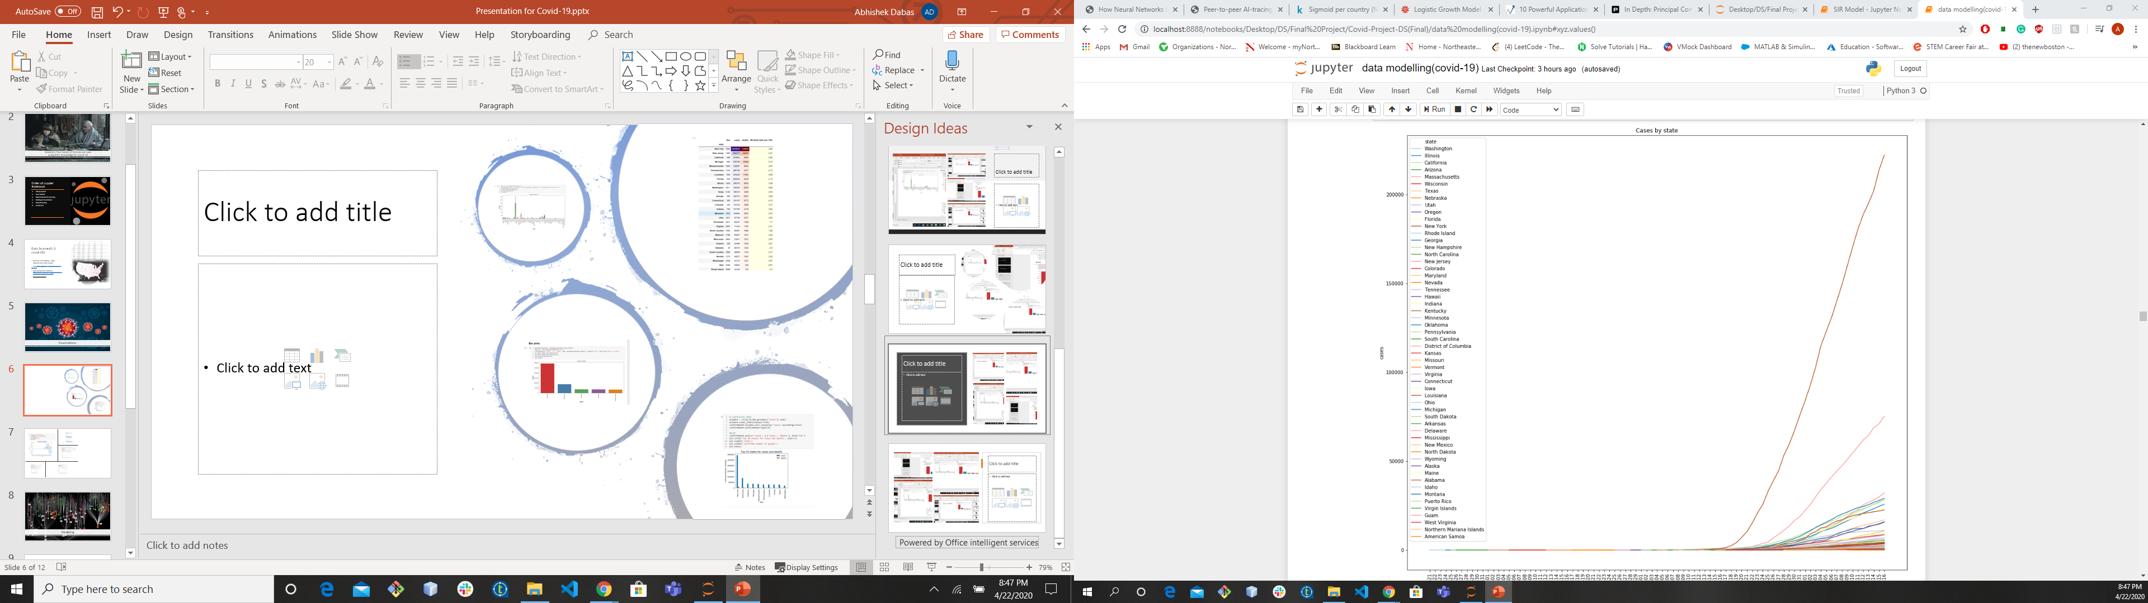
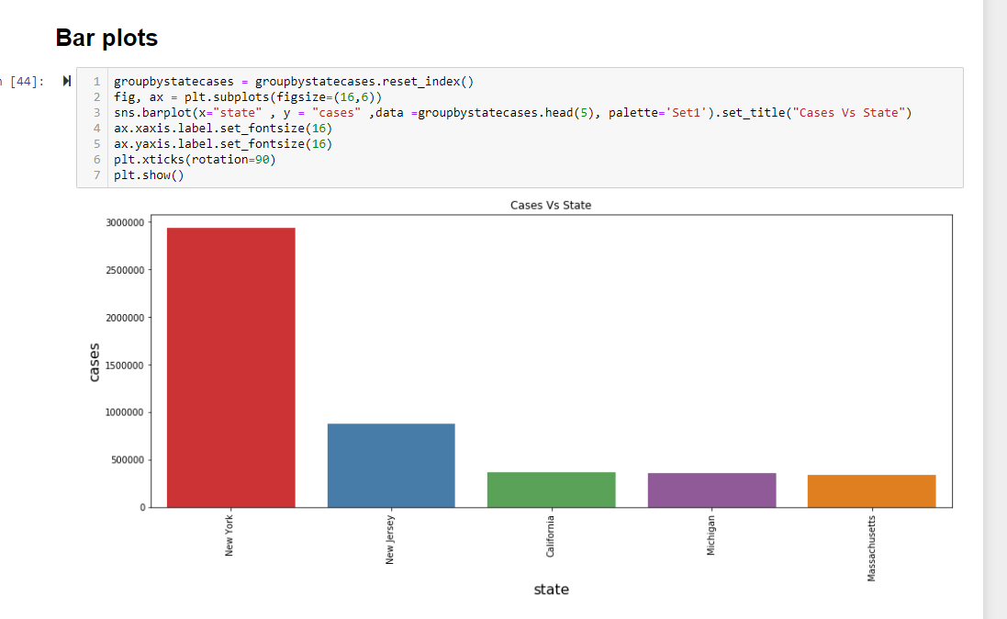
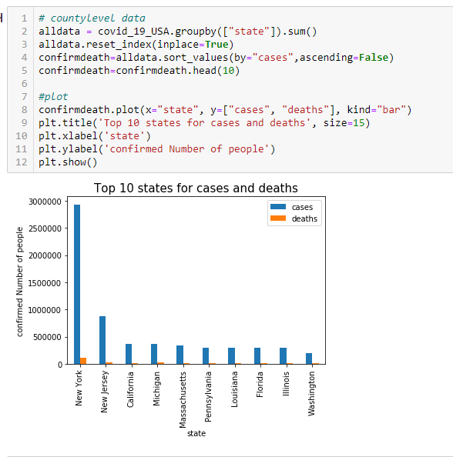

Slide 7
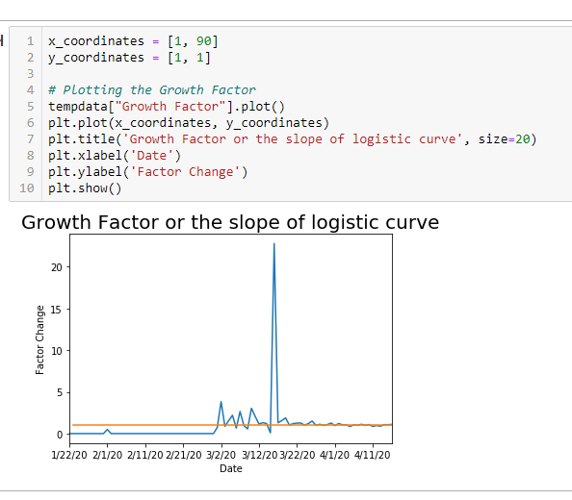
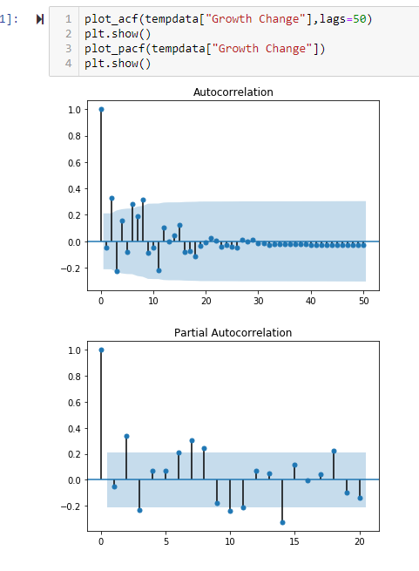
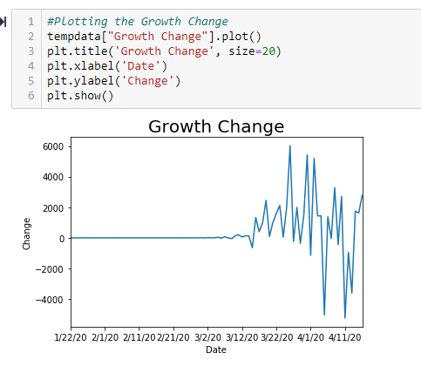
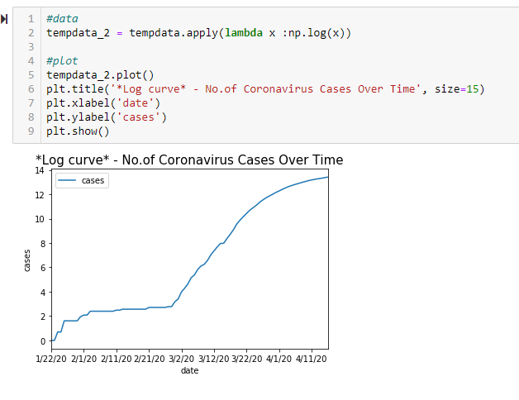
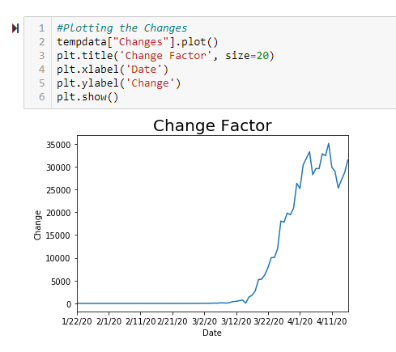

Slide 8
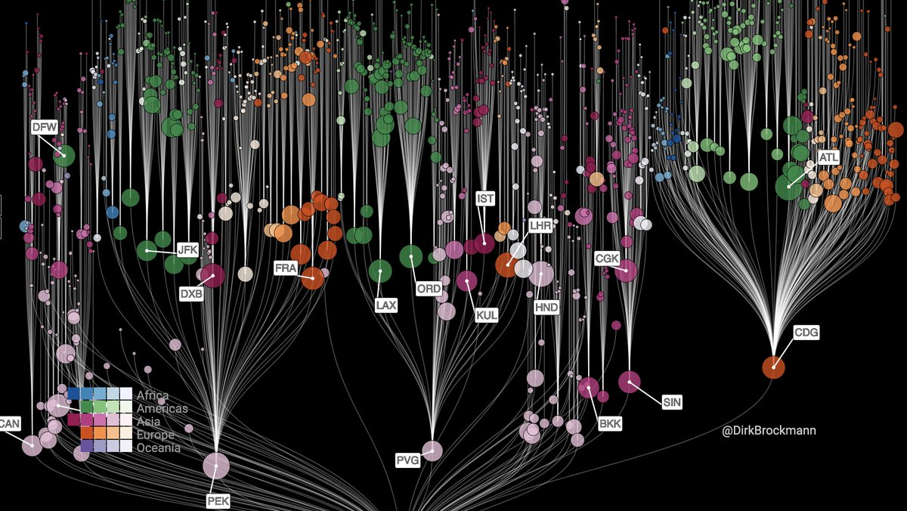
Modelling

Slide 9
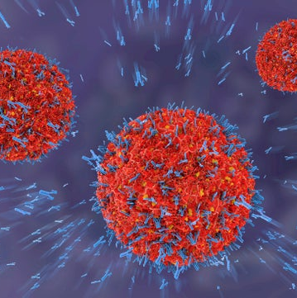
Models Used
1. Arima Model ( Used when there is a linear growth in cases)
2. MLPRegressor (Used when there is a linear growth in cases)
3. Logistic Regression ( Used to fitting into the sigmoid curve for rise in cases)
4. SIR & SEIR ( Used to understanding the complete rise and fall in the infected, recovered cases)

Slide 10
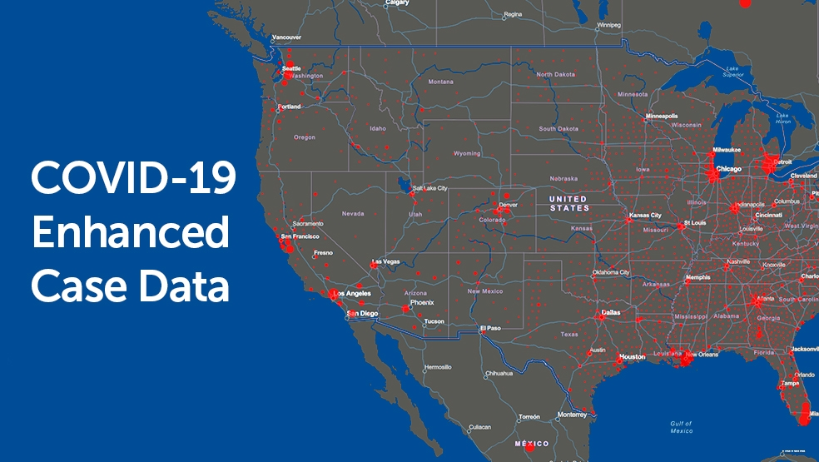
Conclusions:

Slide 11

Conclusions
The rise in Cases follow an exponential Growth in the beginning of the spread
The rise in cases follow an Logistic growth as it reaches a saturation point ( Max of cases being the total Population)
After the slope of the curve or the “Growth Rate” approaches 1, we can say that we have reached the “inflection point” and then from that point the curve will slow down.
SIR Model depicts that, more the Value if R0, more is the Impact of the spread
We have tried to Predict the most accurate Model and tried to plot the outcome for Covid-19 in U.S
Accordingly the max number of cases would be 2X the current cases

Slide 12

Source and References:
1.Avoid contact with people who are sick.
2. Avoid touching your eyes, nose, and mouth.
Stay home when you are sick.
Cover your cough or sneeze with a tissue, then throw the tissue in the trash.
Clean and disinfect frequently touched objects and surfaces using a regular household
Wash your hands often with soap and water, especially after going to the bathroom; before eating; and after blowing your nose, coughing, or sneezing. If soap and water are not readily available, use an alcohol-based hand sanitizer.
1. Social Conectedness Index (SCI) http://pages.stern.nyu.edu/~jstroebe/PDF/SCI.pdf
2. How travel distance of person in most counties changed
https://www.nytimes.com/interactive/2020/04/02/us/coronavirus-social-distancing.html
3.https://www.washingtonpost.com/graphics/2020/world/corona-simulator/
4. https://www.nytimes.com/interactive/2020/04/02/us/coronavirus-social-distancing.html
https://www.cdc.gov/coronavirus/2019-ncov/cases-updates/index.html

